Slide 1
Microservices on AWS
Notes:
https://courses.cs.washington.edu/courses/cse403/13au/lectures/git.ppt.pdf
http://enos.itcollege.ee/~jpoial/allalaadimised/git/getting-started-with-git.pdf

Slide 2
Microservices Reference Architecture on AWS
Microservices are an architectural approach for software that is designed to speed up development cycles and support scalability.
In this approach, the software is composed of small independent services that communicate over well-architected APIs.

Slide 3
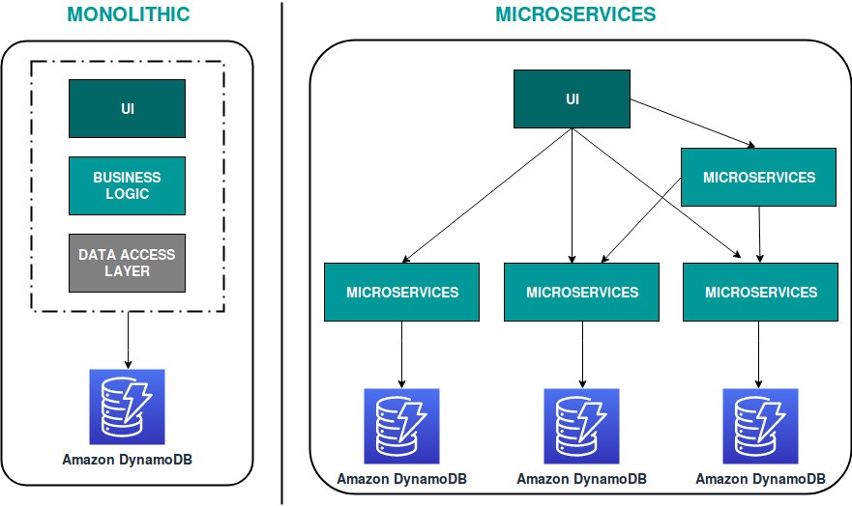
Monolithic vs. Microservices Architecture

Slide 4
Features of Microservices Architecture
Independent
Decentralized
Black Box

Slide 5
Advantages of Microservices Architecture
Quality
Scalability
Easy Development
Resilience

Slide 6
Serverless Microservices Architecture
Complete solution is built without managing any server
This also eliminates the operational efforts of running and monitoring the servers.
Lambda will handle everything required to run and scale the execution to meet actual demand with high availability

Slide 7
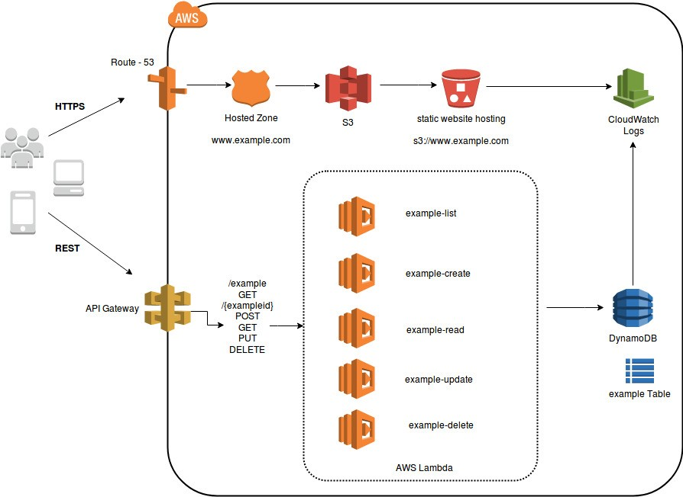
Serverless Microservices Architecture
Lambda is integrated with API Gateway
AWS Lambda will store all the data in a fully managed NoSQL database called DynamoDB
All the static data will be stored in S3 Bucket.

Slide 8
Serverless Microservices with AWS Lambda Functions

Slide 10
Building Microservices with AWS API Gateway

Slide 11
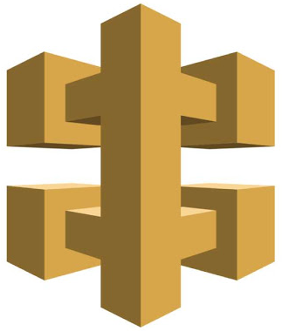
Introducing Amazon API Gateway
A fully managed service that makes it easy for developers to create, publish, maintain, monitor, and secure APIs at any scale:
Host multiple versions and stages of your APIs
Create and distribute API Keys to developers
Throttle and monitor requests to protect your backend
Optional Managed cache to store API responses

Slide 12
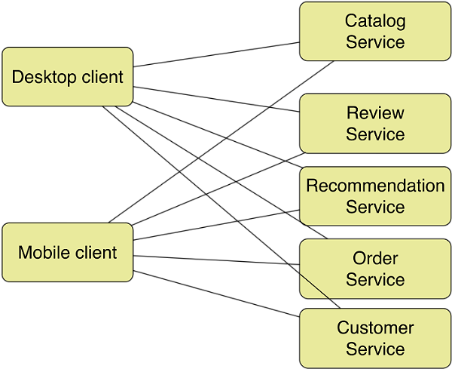
Before implementing an API gateway

Slide 13
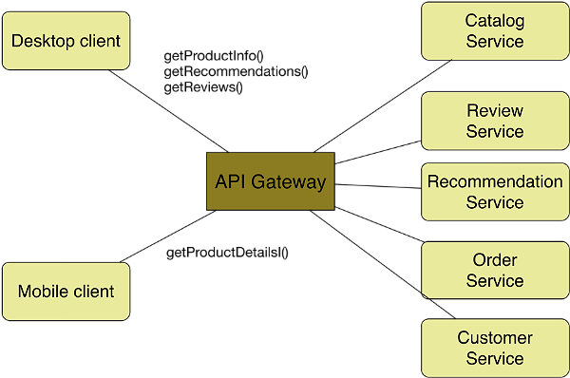
After implementing an API gateway

Slide 14
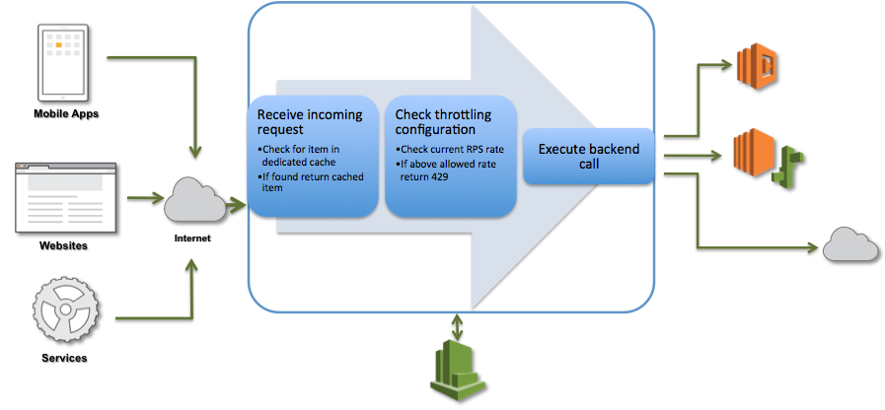
Amazon API Gateway Request Processing Flow

Slide 15
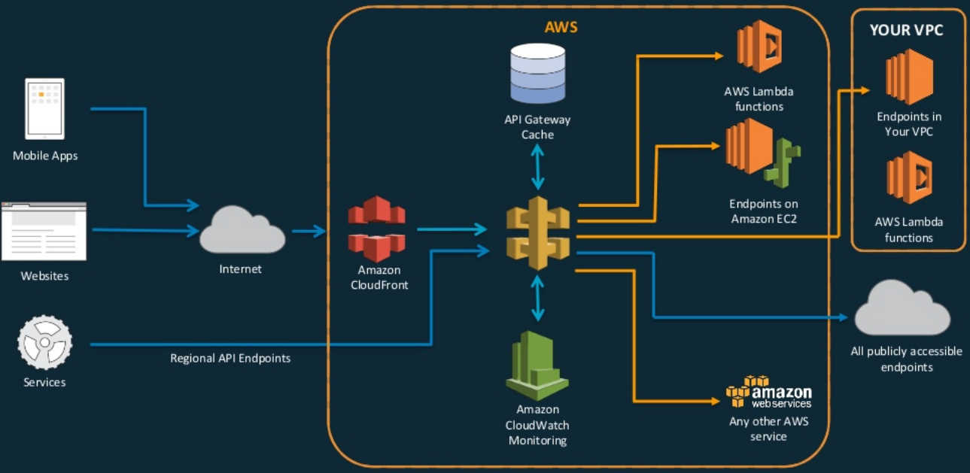
API Gateway Integrations

Slide 16
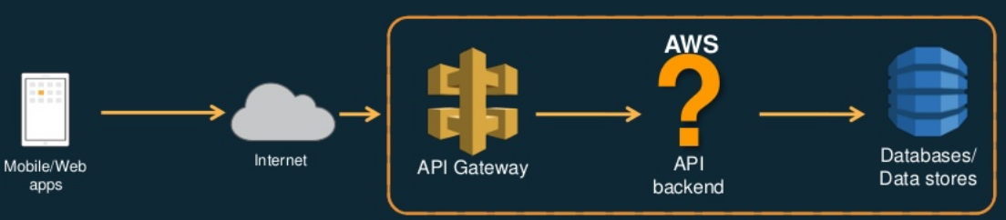
Basic API Technology Stack

Slide 17
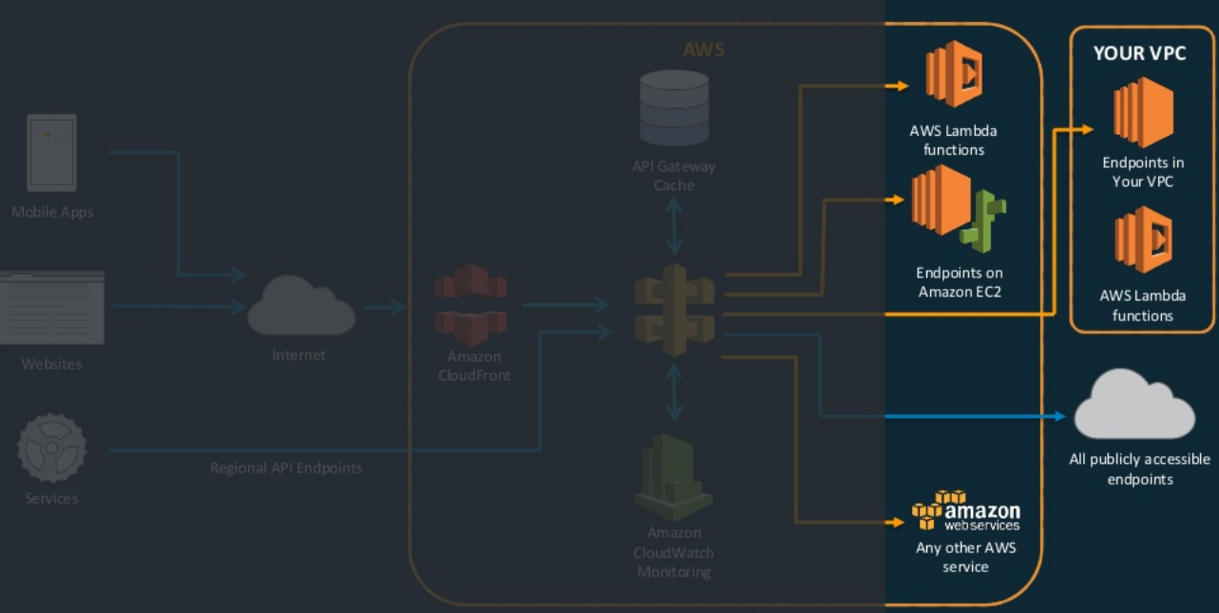
API Gateway Backend Integrations

Slide 18
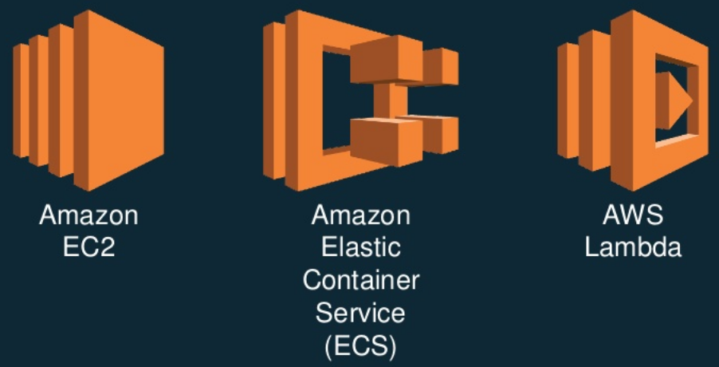
AWS Compute Services

Slide 19
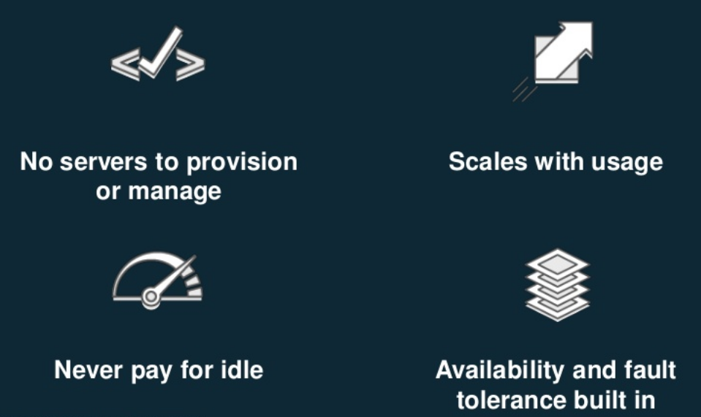
Serverless means?

Slide 20
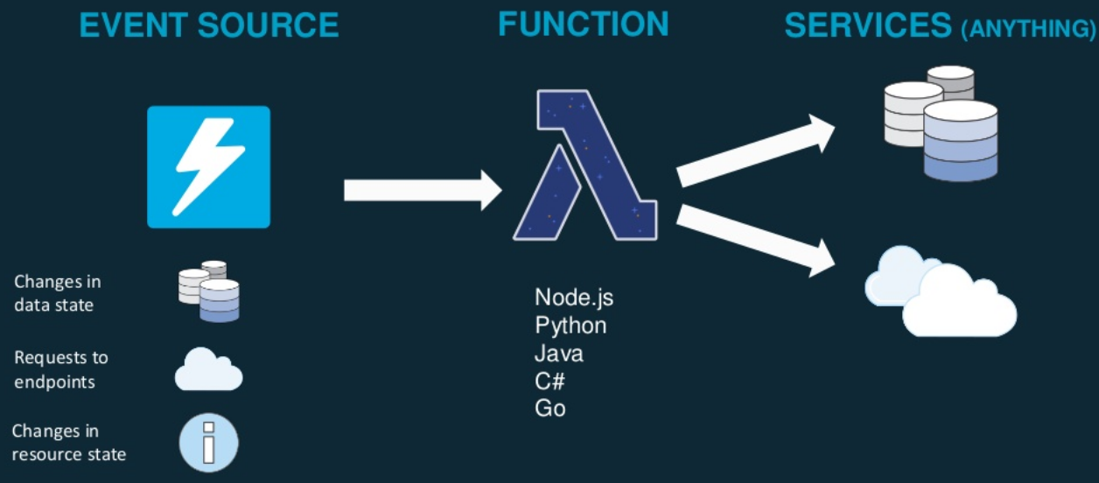
Serverless Applications

Slide 21
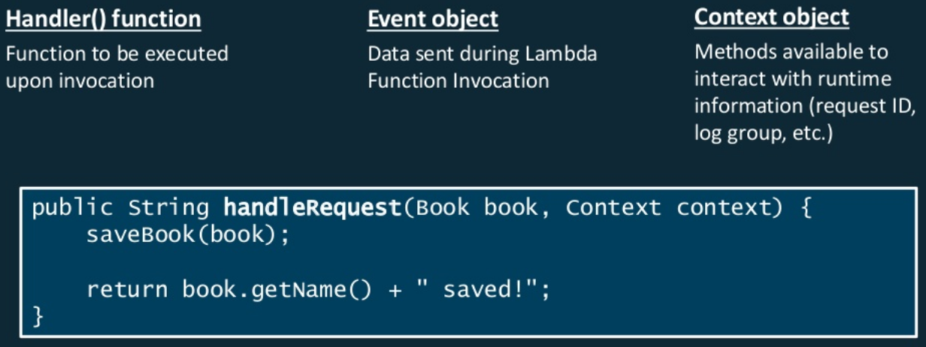
Anatomy of a Lambda Function

Slide 22
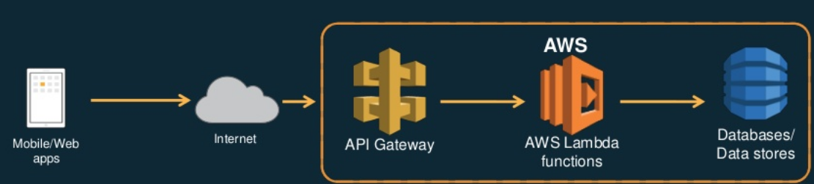
Basic Serverless API Technology Stack

Slide 23
Deploying your applications

Slide 24
API Stages
Stages are named links to a deployed version of your API
Recommended for managing API lifecycle
Dev/test/prod
Alpha/beta/gamma
Support for parameterized values through stage variables API Stages

Slide 25
Amazon API Gateway Canary Support
Use canary release deployments to gradually roll out new APIs in Amazon API Gateway:
Configure percent of traffic to go to a new stage deployment
Can test stage settings and variables
To rollback: delete the deployment or set percent of traffic to 0

Slide 26
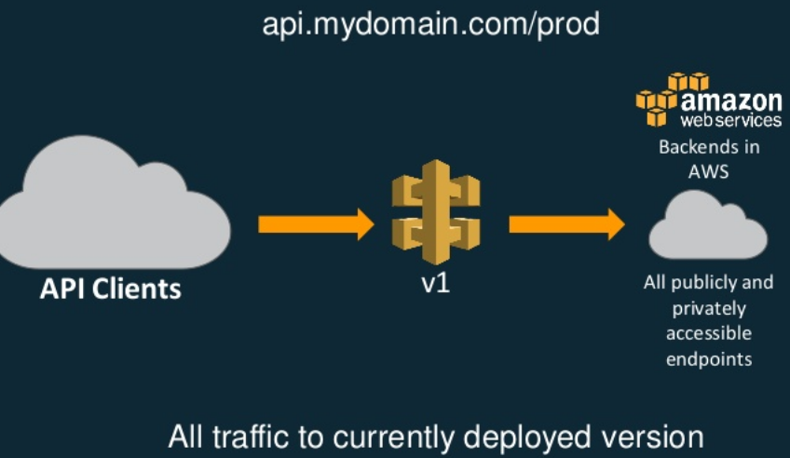
Amazon API Gateway Canary Support

Slide 27
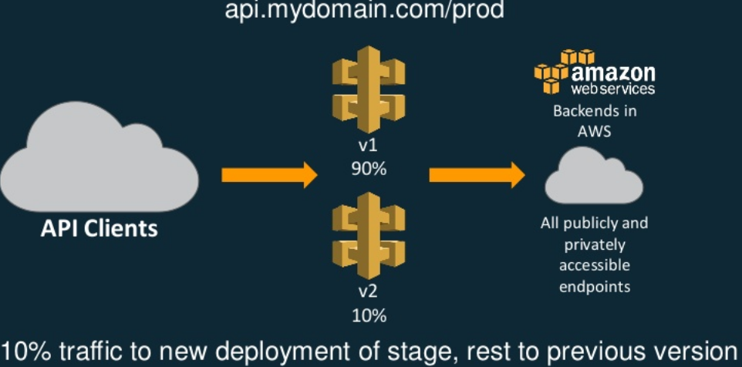
Amazon API Gateway Canary Support

Slide 28
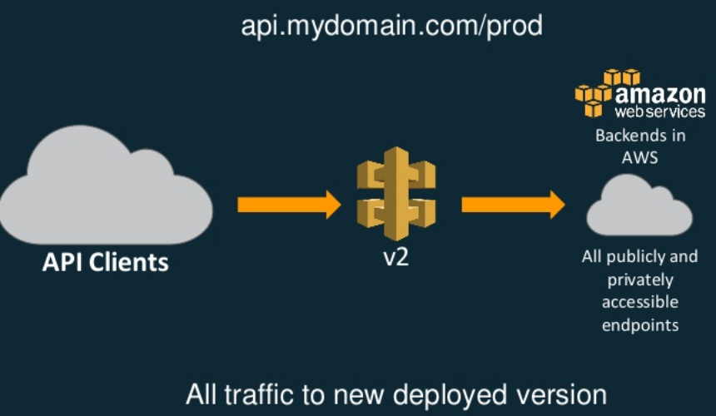
Amazon API Gateway Canary Support

Slide 29
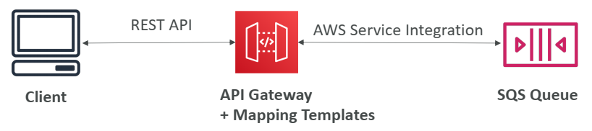
API Gateway - Integration Types
Integration Type MOCK
API Gateway returns a response without sending the request to the backend
Integration Type HTTP / AWS (Lambda & AWS Services)
Must configure both the integration request and integration response
Setup data mapping using mapping templates for the request & response

Slide 30
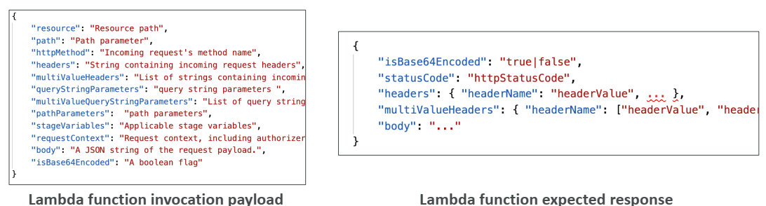
API Gateway - Integration Types
Integration Type AWS_PROXY (Lambda Proxy):
incoming request from the client is the input to Lambda
The function is responsible for the logic of request / response
No mapping template, headers, query string parameters… are passed as arguments

Slide 31
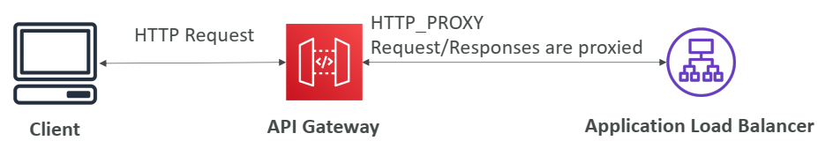
API Gateway - Integration Types
Integration Type HTTP_PROXY
No mapping template
The HTTP request is passed to the backend
The HTTP response from the backend is forwarded by API Gateway

Slide 32
Mapping Templates (AWS & HTTP Integration)
Mapping templates can be used to modify request / responses
Rename / Modify query string parameters
Modify body content
Add headers
Uses Velocity Template Language (VTL): for loop, if etc…
Filter output results (remove unnecessary data)

Slide 33
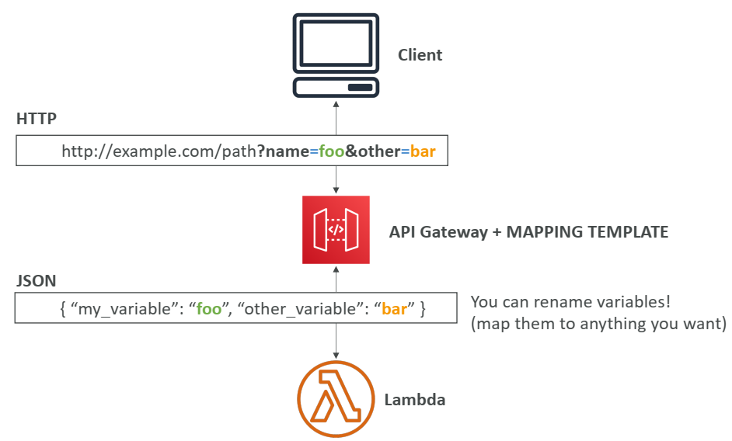
Mapping Example: Query String parameters

Slide 34
AWS API Gateway Swagger / Open API spec
Common way of defining REST APIs, using API definition as code
Import existing Swagger / OpenAPI 3.0 spec to API Gateway
Can export current API as Swagger / OpenAPI spec
Swagger can be written in YAML or JSON
Using Swagger we can generate SDK for our applications

Slide 35
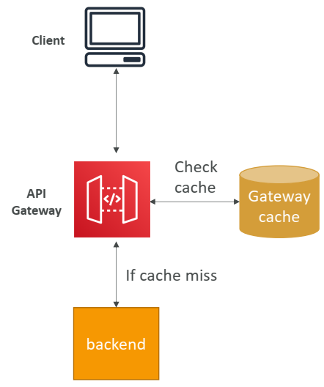
Caching API responses
Caching reduces the number of calls made to the backend
Default TTL (time to live) is 300 seconds (min: 0s, max: 3600s)
Caches are defined per stage
Possible to override cache settings per method
Cache encryption option
Cache capacity between 0.5GB to 237GB
Cache is expensive, makes sense in production, may not make sense in dev / test

Slide 36
Messaging with SQS and SNS

Slide 38
Containerization of Microservices with AWS ECS and ECR

Slide 40
Monitoring of Microservices with AWS

Slide 42
Distributed Tracing with AWS X-Ray

Slide 44
Log Analysis with AWS Elastic Stack

Slide 46
Auditing Microservices with CloudTrail and CloudWatch

Slide 48
Securing Microservices with AWS

Slide 50
Thanks

